Slide 1
Azure Resource Manager (ARM)
Infrastructure as Code (IaC)
Rick Rainey
Twitter: @RickRaineyTx | Blog: http://rickrainey.com | Email: rickra@microsoft.com
Notes:
This session takes about 90 mins to get complete through the content. If you need to cut time, then cut the DSC section.

Slide 2
Agenda
Azure Resource Manager (ARM) Introduction
Introduction to ARM Templates
Authoring ARM Templates
ARM Template Deployments
Desired State Configuration (DSC)

Slide 3
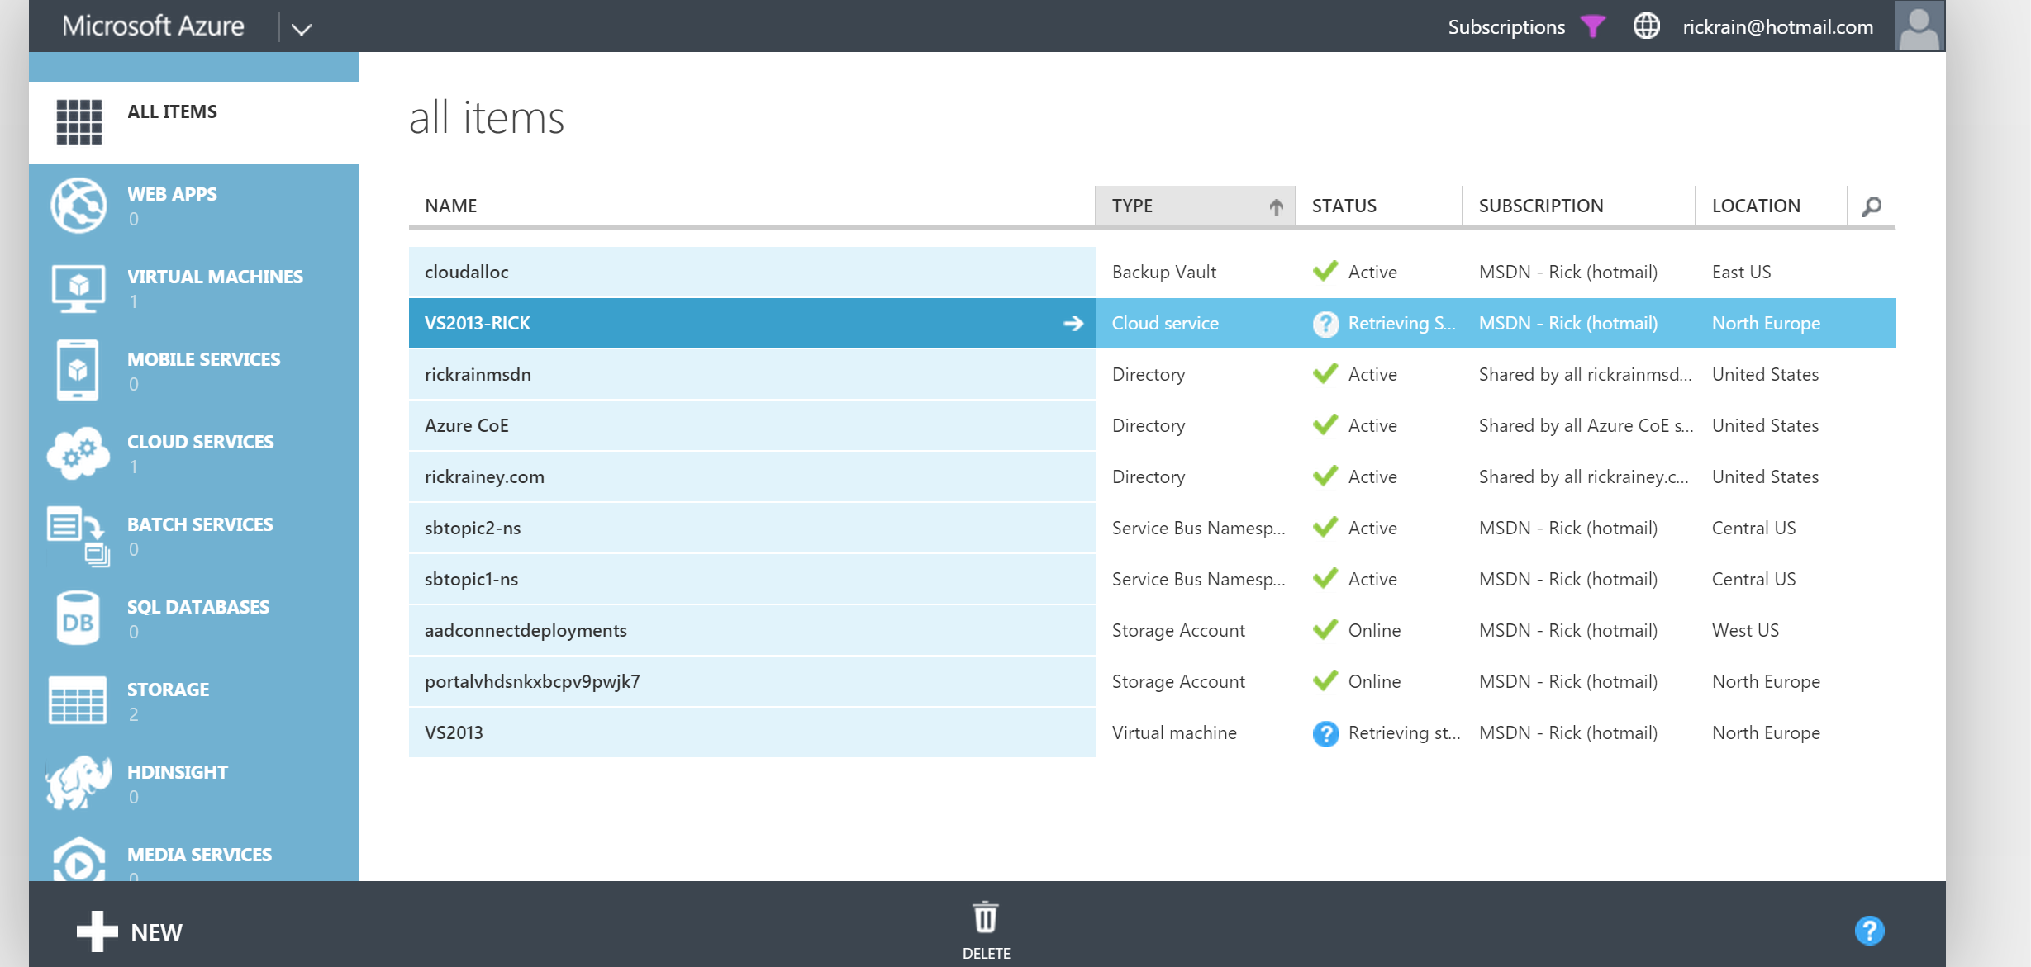
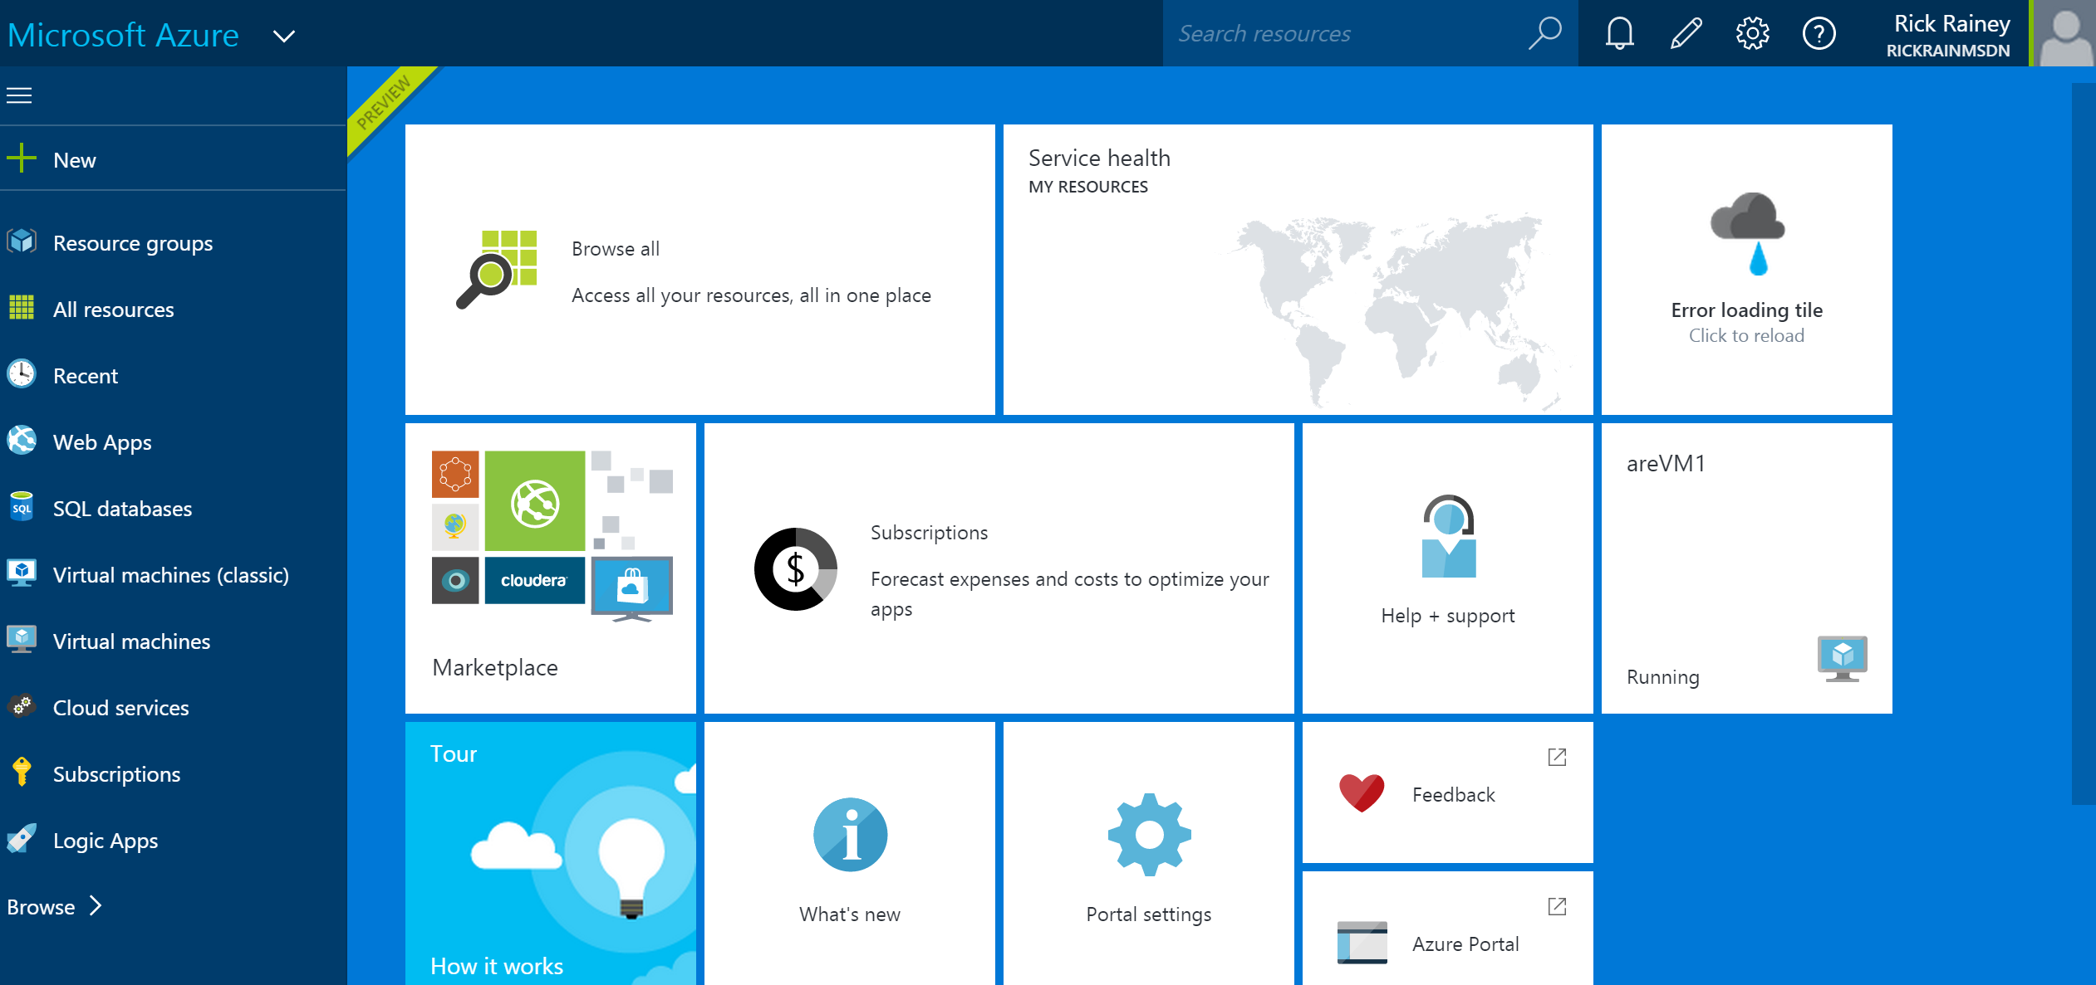
Provisioning Resources in Azure
Azure Service Mgmt (ASM)
Azure Resource Mgr (ARM)
Old
New
Imperative
Serial resource provisioning
Non-idempotent
Declarative
Parallel resource provisioning
Idempotent

Slide 4





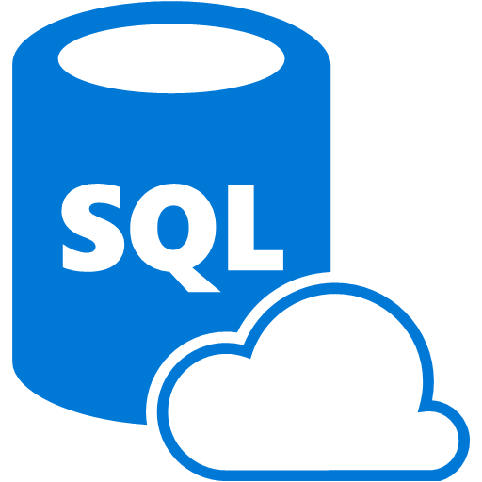




Azure Resource Manager Architecture
Microsoft Azure
ARM Key Takeaways
A resource always belongs to a Resource Group (RG)
RG is a unit of management
RBAC support
Custom policies
Azure Subscription
Resource Group
LOB App
Resource Group
IaaS Workload
Resource Providers
Azure Resource Manager (ARM)
REST API Endpoints

Slide 5
Introduction to ARM Templates

Slide 6
What is an ARM Template?
JSON files – “Infrastructure-as-Code”
Artifacts (optional depending on resources)
Configuration files to apply to resources
Examples:
Desired State Configuration (DSC) Script and DSC Resources
Also “Infrastructure-as-Code”
Web Deployment Packages

Slide 7
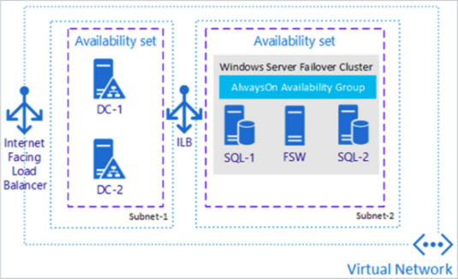
Finding Existing Templates
Azure Quick-Start Templates
http://aka.ms/qst
Azure Marketplace via Portal
Examples:
SQL Server Always-On Cluster
SharePoint 2013 HA Farm

Slide 8
Azure Resource Manager Templates
Notes:
Show a quick start template and explain the JSON and optional “artifacts” (ie: DSC for a DC VM).
Show how to export an ARM template for a resource group using the Azure portal.

Slide 9
Authoring ARM Templates

Slide 10
ARM Template Structure
{
"$schema": "https://schema.management.azure.com/schemas/2015-01-01/deploymentTemplate.json#",
"contentVersion": "1.0.0.0",
"parameters": {
// Parameters referenced by resources (parameterize your template)
},
"variables": {
// Variables referenced by resources
},
"resources": [
// Virtual Machine, Web App, Virtual Network, SQL Azure, Storage Account, etc.
],
"outputs": {
// Optional outputs from deployment
}
}

Slide 11





Author & Deploy ARM Templates
Deployment template (JSON)
Deployment template parameters (JSON)
Microsoft Azure
Deployment script (PowerShell)
Azure Subscription
Push Deployment template and parameters to ARM
Resource Group
Resource Group
ARM

Slide 12
A Few Common ARM Template Functions
concat() – string concatenation
uniqueString() – 64-bit hash of a given string
resourceGroup() – resource group instance of deployment
resourceId() – unique identifier of a resource
copyIndex() – looping construct (ie: 20 VM’s)
http://aka.ms/armfunc

Slide 13
Author an ARM Template
Notes:
Create an ARM template from scratch to provision a single VM. Don’t add the public IP address resource – you just want to show how to author the minimum resources to provision a VM.

Slide 14
ARM Template Deployments

Slide 15
Methods for Deploying ARM Templates
PowerShell
Azure PowerShell Cmdlets 1.0 (or new) – “AzureRm” cmdlets
Azure Command-Line Interface (CLI)
Cross-platform tools for Mac, Linux, and Windows
Visual Studio
Azure Tools / SDK
Azure Portal
“Template Deployment”
Continuous Deployment

Slide 16
ARM Template Deployment
Notes:
Show how to deploy the ARM template from the previous demo using Visual Studio, PowerShell, and CLI.

Slide 17
Web Apps & Web Deploy Extension

Slide 18
ARM Resources for Web Apps
App Service Plan (Server Farm)
Web App
Application Settings for Web Apps
Web Deploy for Web Apps

Slide 19
Web App Deployment using ARM
Notes:
Show how to deploy a web deploy package. Hint: Can use the web deploy package from the Traffic Manager demo in the networking session if you don’t want to build your own.

Slide 20
Desired State Configuration (DSC)

Slide 21
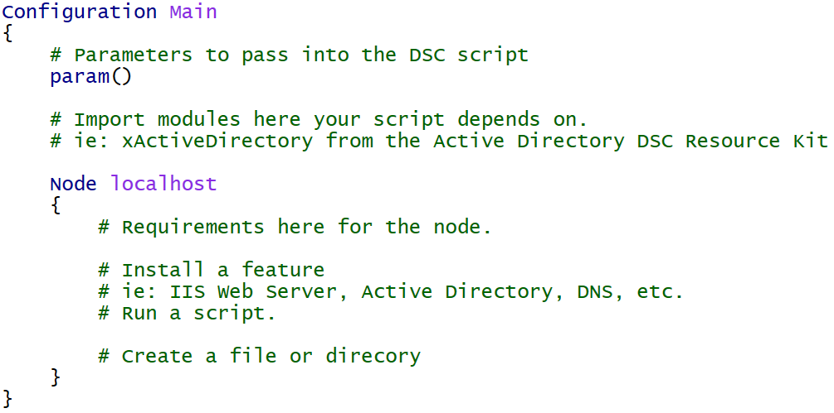
DSC for Azure
Declarative configuration of the virtual machine
Windows Features and Roles
Custom application configuration

Slide 22
DSC Example: Built-in Resources
Configuration Main {
Param ( [string] $nodeName )
Import-DscResource -ModuleName PSDesiredStateConfiguration
Node $nodeName {
WindowsFeature WebServerRole {
Name = "Web-Server"
Ensure = "Present"
}
Package InstallWebDeploy {
Ensure = "Present"
Path = "C:\WindowsAzure\WebDeploy_amd64_en-US.msi"
Name = "Microsoft Web Deploy 3.6"
ProductId = "{ED4CC1E5-043E-4157-8452-B5E533FE2BA1}"
Arguments = "ADDLOCAL=ALL"
}
Service StartWebDeploy {
Name = "WMSVC"
StartupType = "Automatic"
State = "Running"
DependsOn = "[Package]InstallWebDeploy"
}
}
}

Slide 23
DSC Resources
Built-in
WindowsFeature, File, Package, Service, Script, etc.
DSC Resource Kit (~500 resources)
https://blogs.msdn.microsoft.com/powershell/2016/02/11/dsc-resource-kit-gets-even-bigger/
Experimental Resources
xNetworking, xDisk, xSqlServer, xActiveDirectory, etc.
Community Resources
cUserRightsAssignment, cNtfsAccessControl, etc.

Slide 24
DSC Example: Resource-Kit Resources
Configuration Main {
Param ( [string] $nodeName )
Import-DscResource -ModuleName PSDesiredStateConfiguration, xNetworking, cUserRightsAssignment
Node $nodeName {
WindowsFeature DNS {
Ensure = "Present"
Name = "DNS"
}
xDnsServerAddress DnsServerAddress {
Address = "127.0.0.1"
InterfaceAlias = "Ethernet"
AddressFamily = "IPv4"
DependsOn = "[WindowsFeature]DNS"
}
cUserRight GrantIncreaseQuotaPrivilege
{
Ensure = "Present"
Constant = "SeIncreaseQuotaPrivilege"
Principal = "CONTOSO\AdminUser"
}
}
}

Slide 25
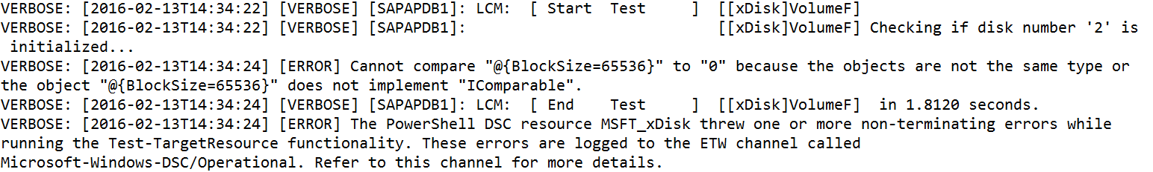
DSC Logs
Provides details on the configuration (script) in the virtual machine
C:\WindowsAzure\Logs\Plugins\Microsoft.Powershell.DSC\<version>

Slide 26
DSC Package Locations
C:\Packages\Plugins\Microsoft.Powershell.DSC\<version>

Slide 27
Desired State Configuration (DSC)
Notes:
Show how to add to a VM
Remote into a VM and show the DSC logs

Slide 28
Additional information
MVA: Deep Dive into Azure Resource Manager Scenarios and Patterns (3 hours)
http://bit.ly/1q0xPlH
Best Practices: Resource Manager Template Design
http://bit.ly/200uz6l
Introduction to ARM (blog)
http://bit.ly/1ovyRF8
Author ARM Templates using Visual Studio (blog)
http://bit.ly/1UQqNgG
ARM Template Deployments (blog)
http://bit.ly/1V4GU9X
Azure Automation DSC
http://bit.ly/1RQ8V3x

Slide 29
Summary
Azure Resource Manager (ARM) Introduction
Introduction to ARM Templates
Authoring ARM Templates
ARM Template Deployments
Desired State Configuration (DSC)

